Slide 1
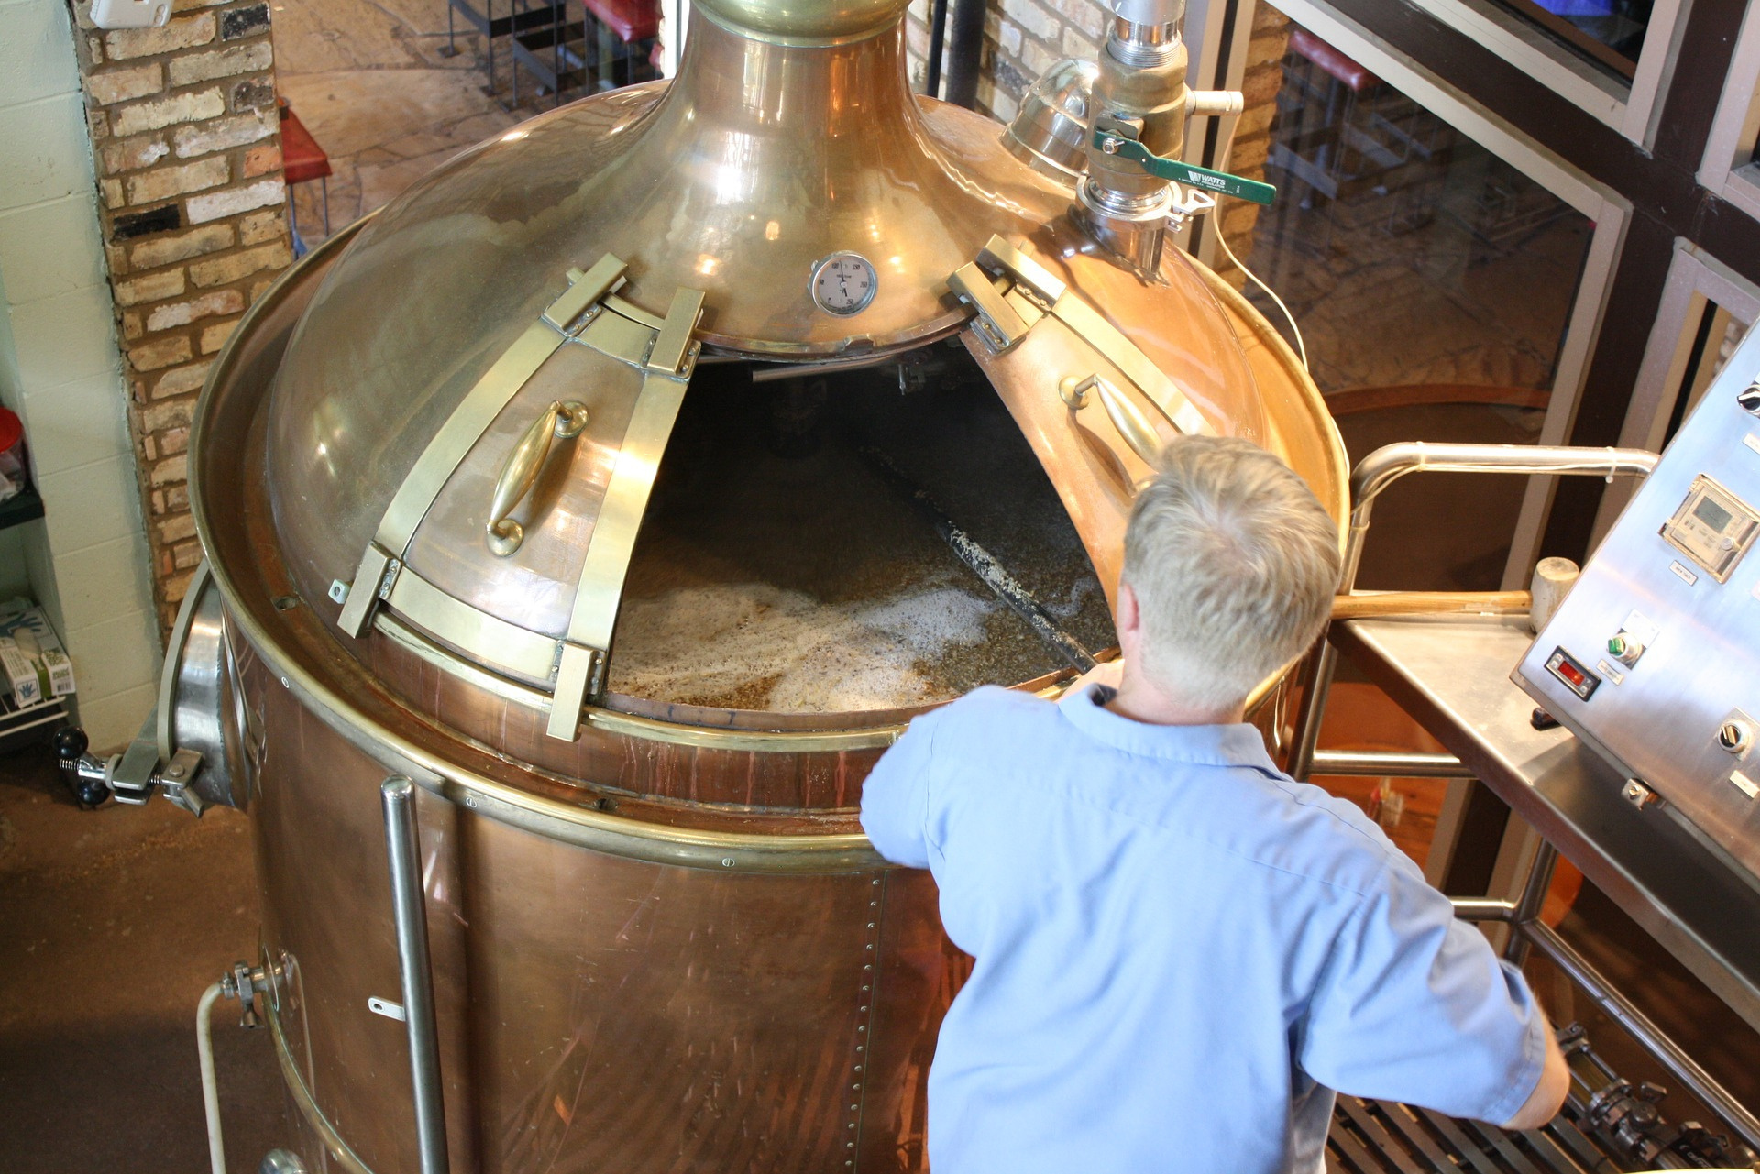
Reporting our Insights

Slide 2
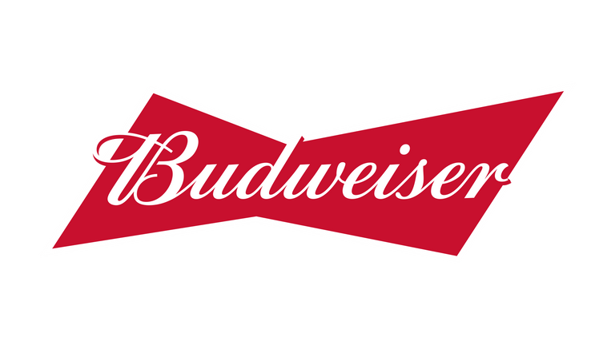


Budweiser
CASE STUDY 1 | OCTOBER 21, 2021
Authors
Richard Kim
Joaquin Dominguez
CO-AUTHOR
CO-AUTHOR
Data Science Master's Student at Southern Methodist University.
Data Science Master's Student at Southern Methodist University.

Slide 3
Budweiser
CASE STUDY 1 | OCTOBER 11, 2021
Roadmap
Part 1: Initial Look
Part 2: Insights
Part 3: Exploring
Broad overview
Importance of our findings
ABV and IBU Summary
What else?
How is this useful?

Slide 4
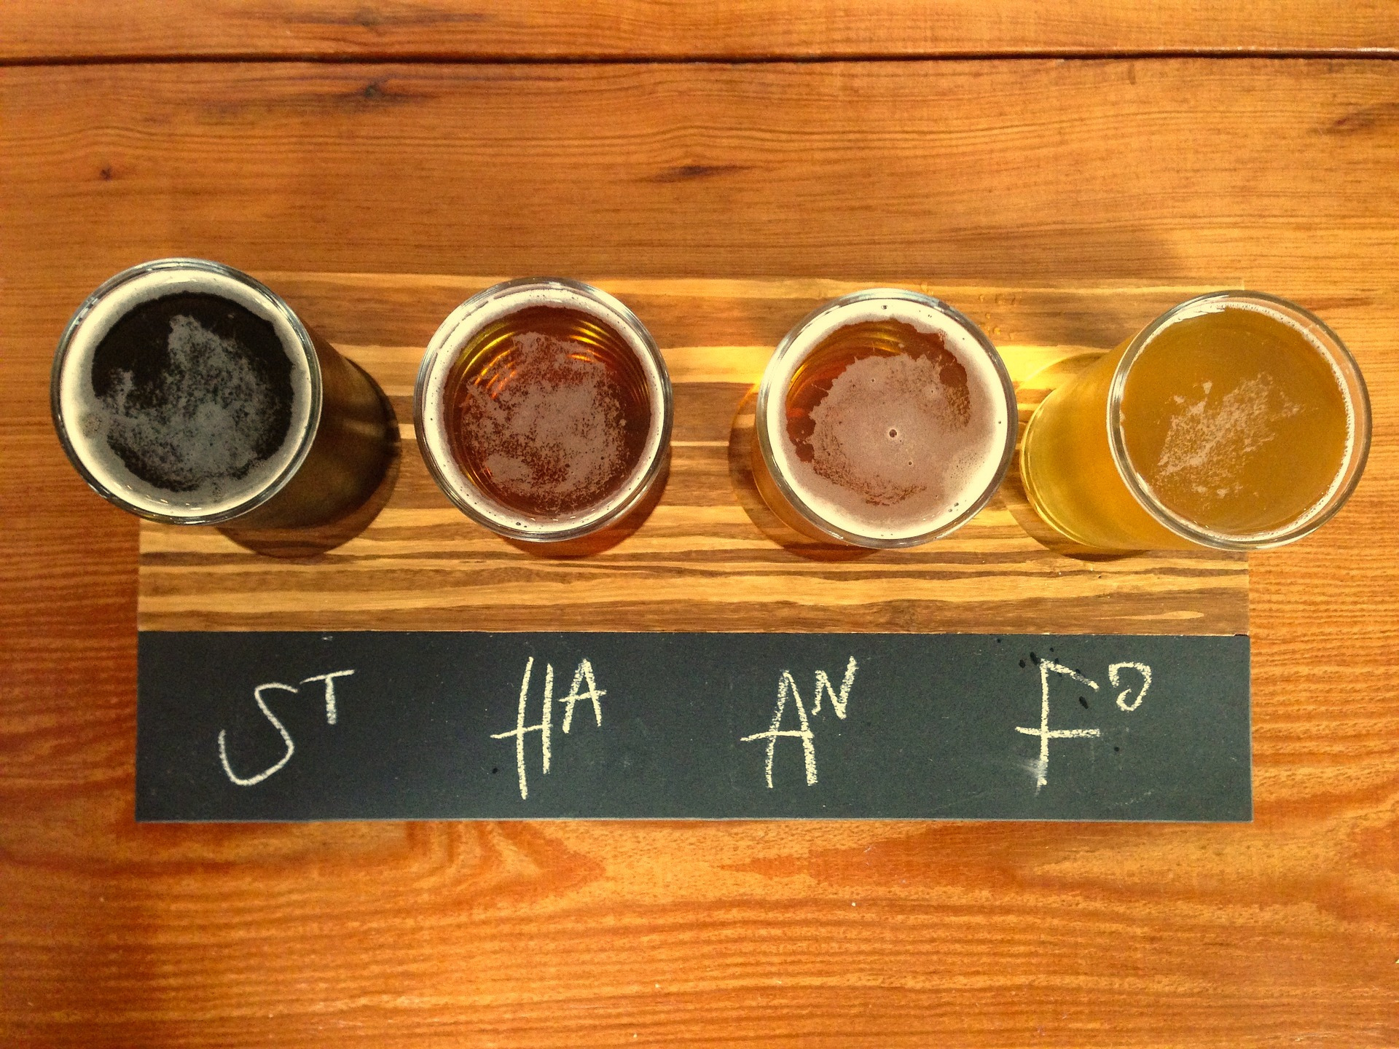
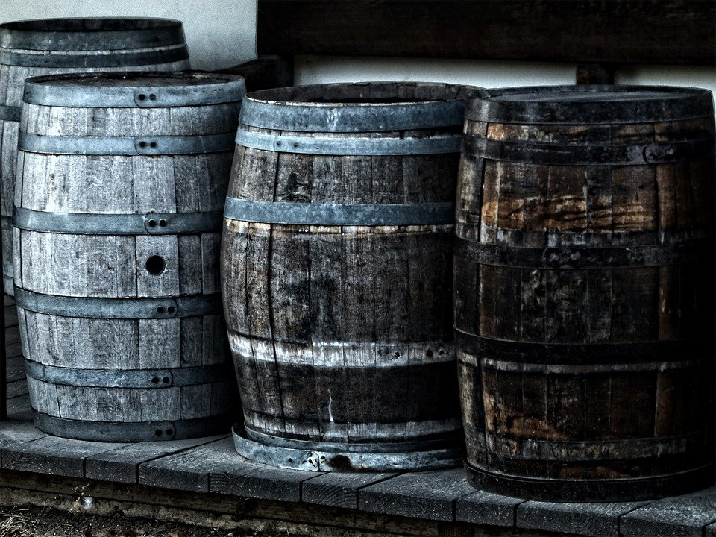
Budweiser
Part 1:
Initial Look

Slide 5
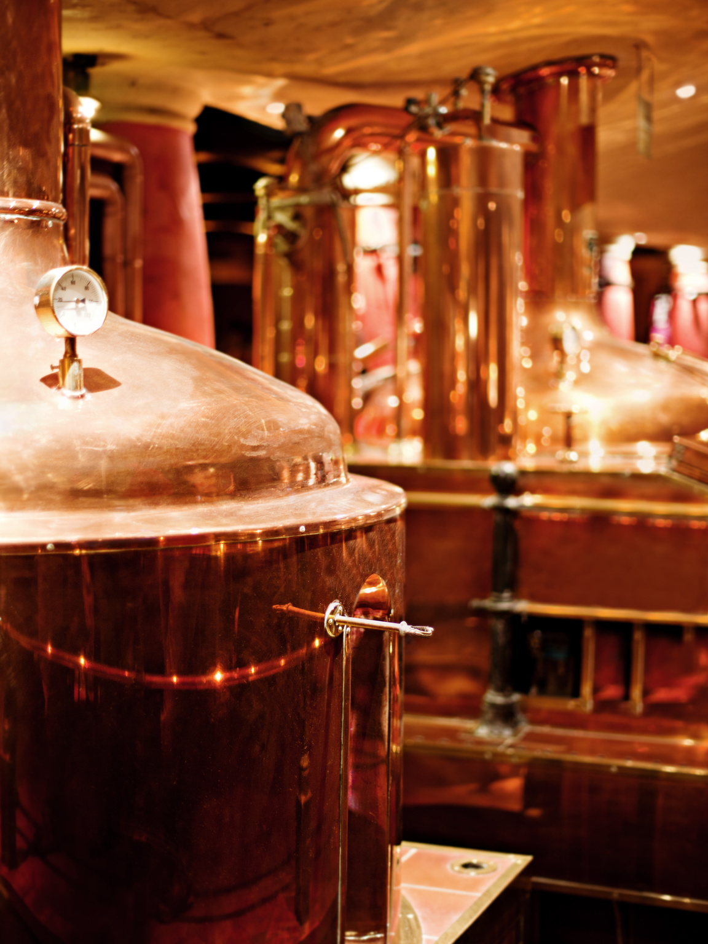

Merging and Missing Values

Slide 6
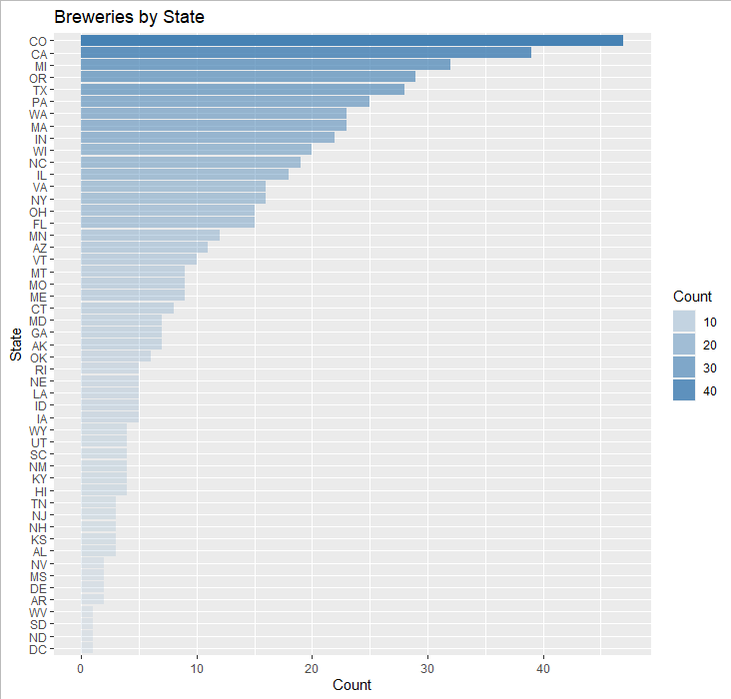
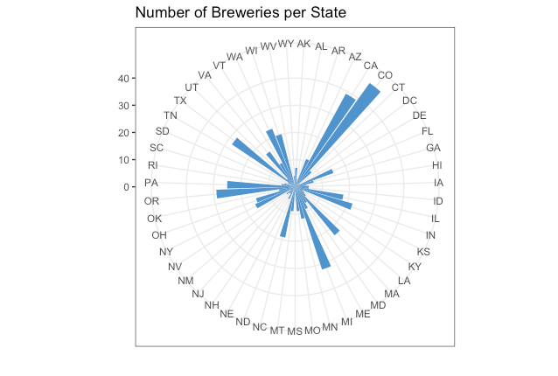
Budweiser
Breweries by State
Visualization of data depicting Number of Breweries per State.

Slide 7
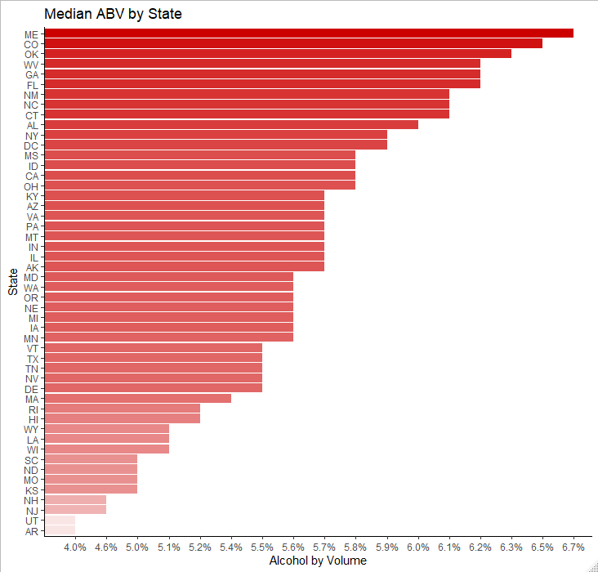
Budweiser
Median ABV by State:
Highest median ABV in Maine

Slide 8
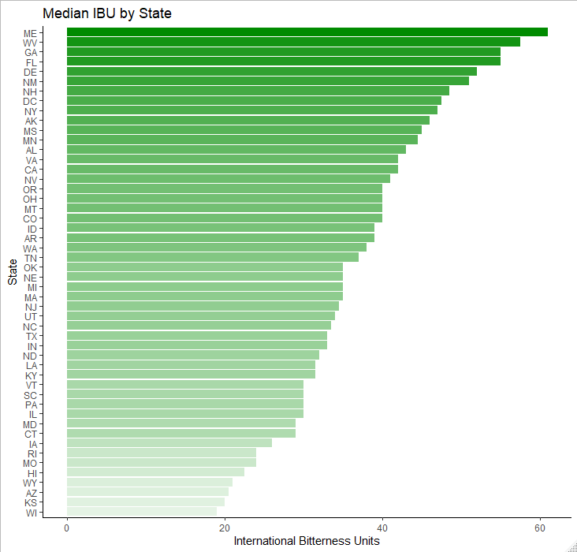
Budweiser
Budweiser
Median IBU by State:
Highest median IBU in Maine

Slide 9
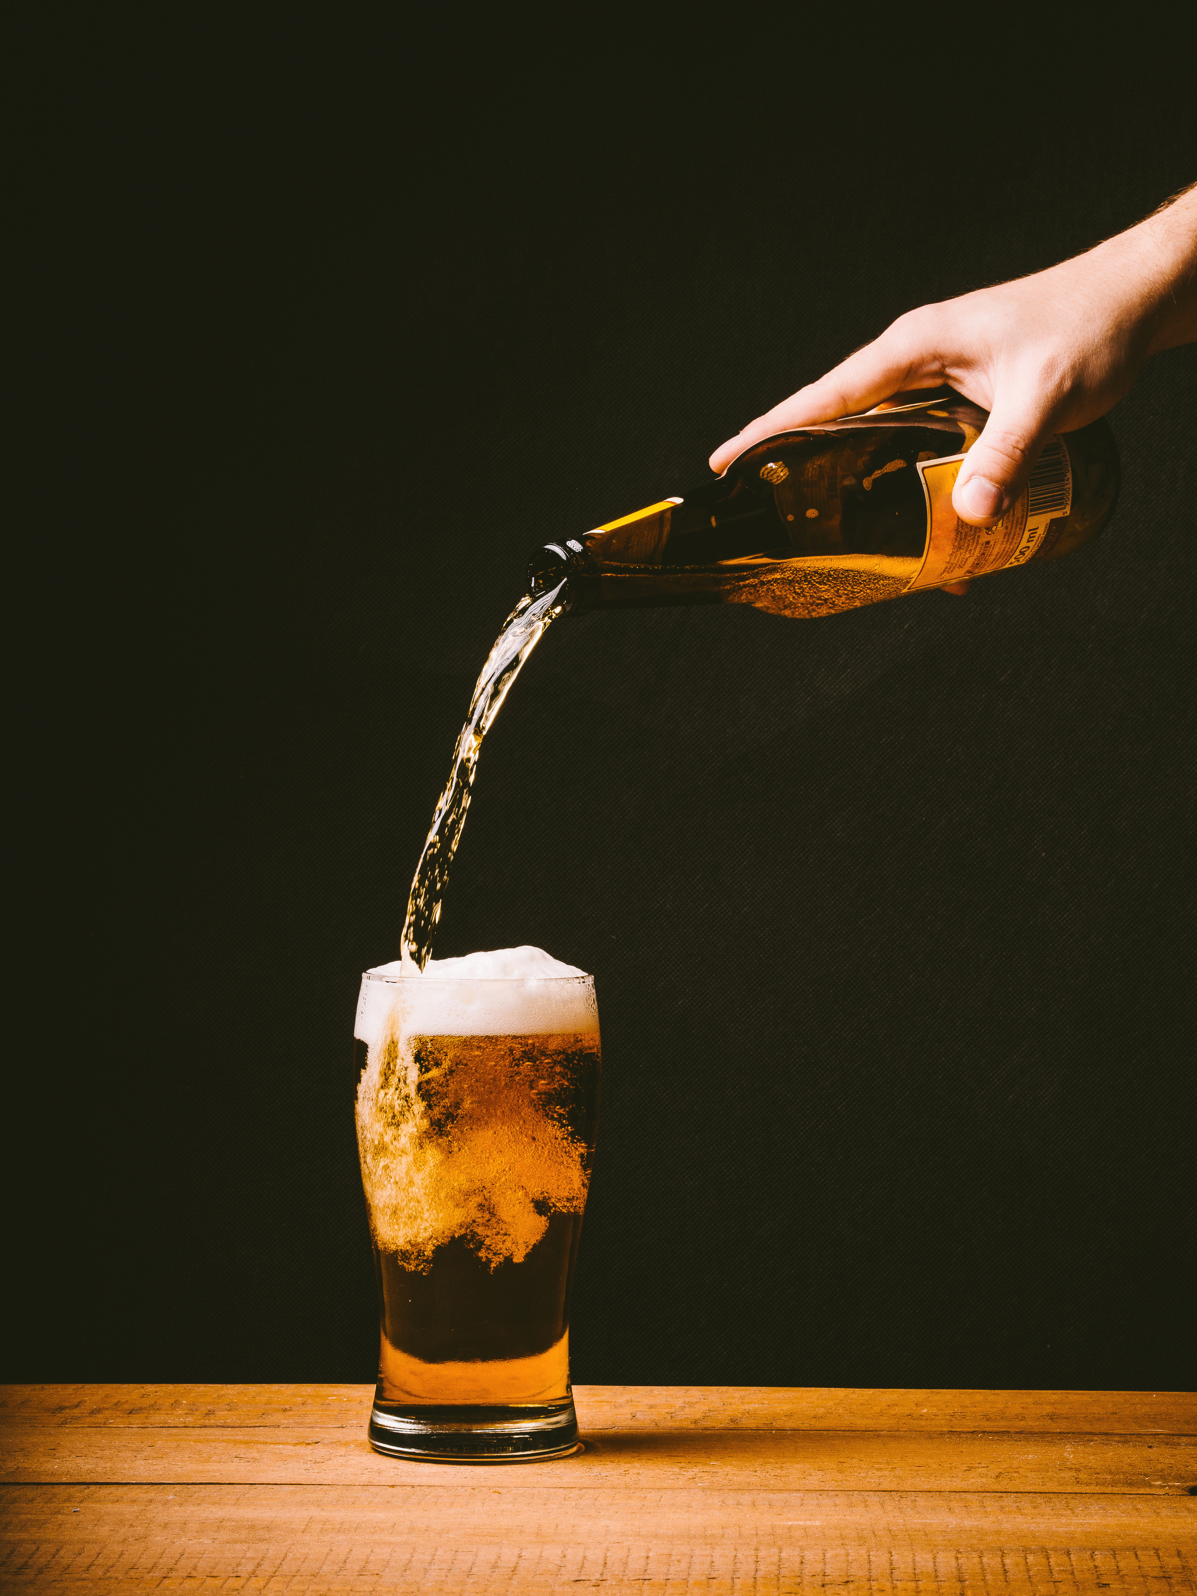

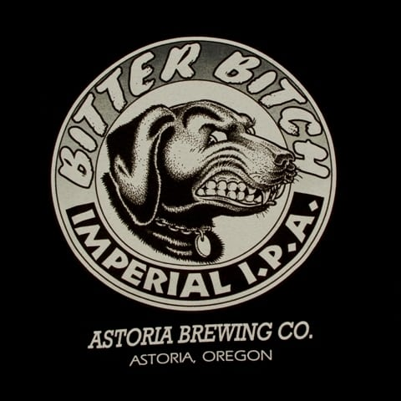
Budweiser
Kentucky
Oregon
12.5% ABV
138 IBU

Slide 10
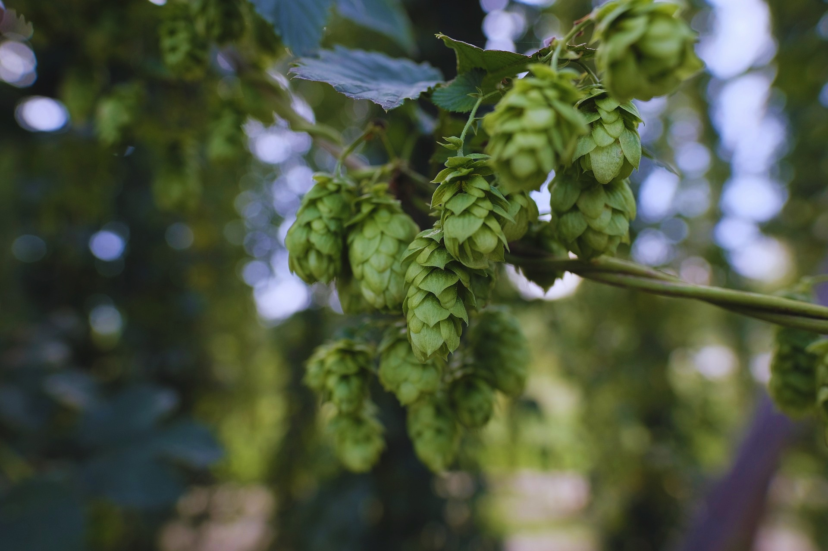
Budweiser
Part 2:
Insights

Slide 11
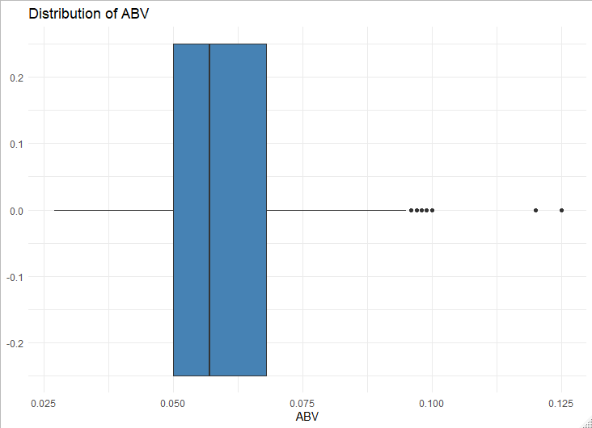
Budweiser
Summary Statistics (ABV)
Right-skew
Outliers causing skew

Slide 12
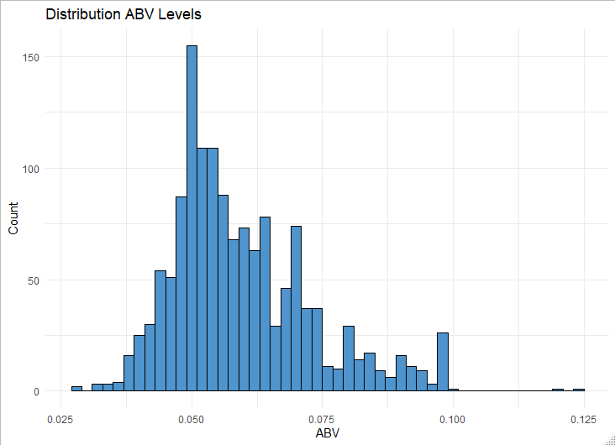
Budweiser
ABV Distribution
Median 5.70%
Mean
5.99%
Outlier12.5%
Mean and median close
Without outlier

Slide 13
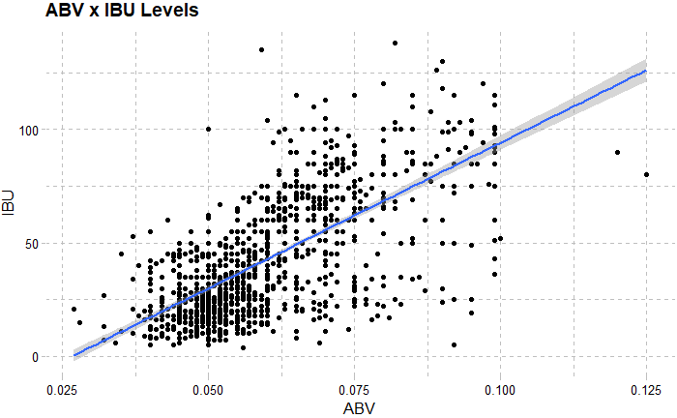
Budweiser
Relation between ABV and IBU
We used a scatterplot to visualize this relation
No causal inference
44.9% of variance explained

Slide 14


Machine Learning
IPAs vs Other Ales
Overall Accuracy: 87.2%
Classifying IPAs: 86.7%
Classifying Ales: 87.5%
Highlighting the importance of ABV and IBU

Slide 15

Part 3:
Exploring

Slide 16
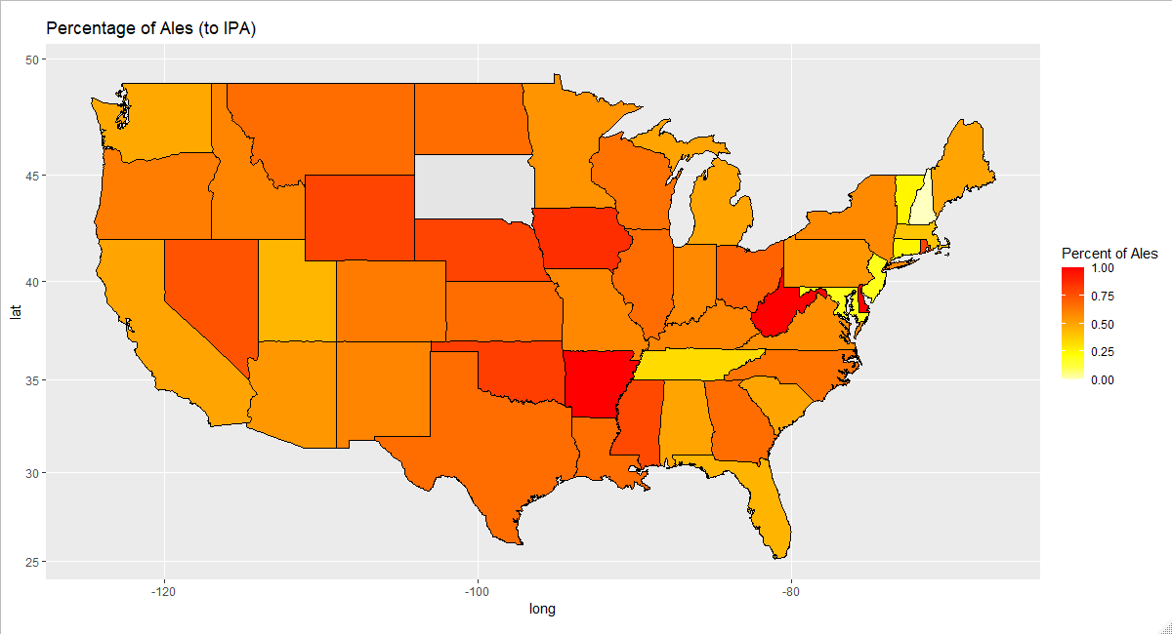
Budweiser
Arkansas
West Virginia
Central region…
How are IPAs and Other Ales distributed across the USA?

Slide 17
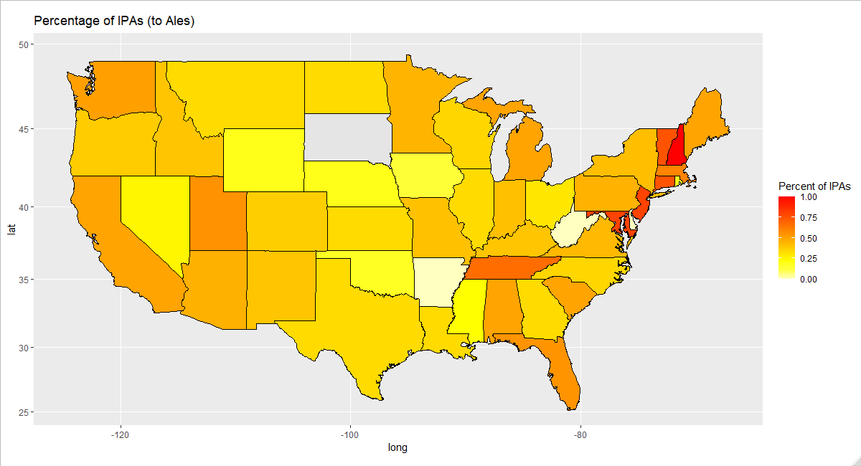
Budweiser
New Hampshire
Vermont
New Jersey
Maryland

Slide 18


Budweiser
Next Steps
Action Step 1
Action Step 2
Action Step 3
Sales and profits by location
Other types of beer
Discover new insights

Slide 19
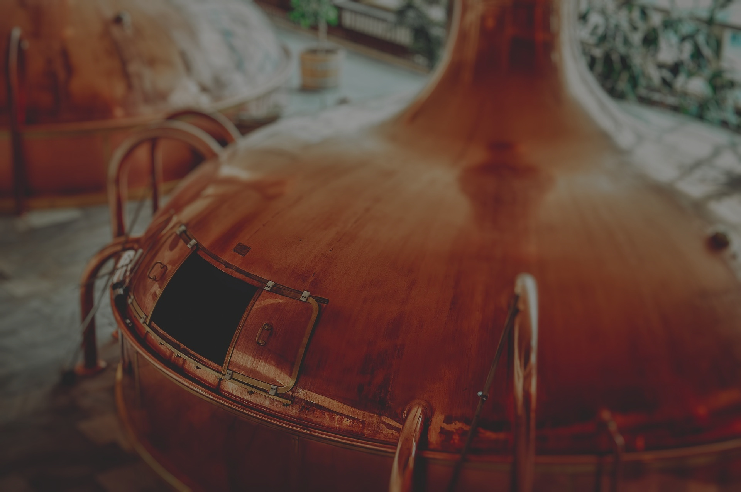
Budweiser
Thank you!
Richard Kim
richardk@smu.edu
Joaquin Dominguez
joaquind@smu.edu

Slide 20
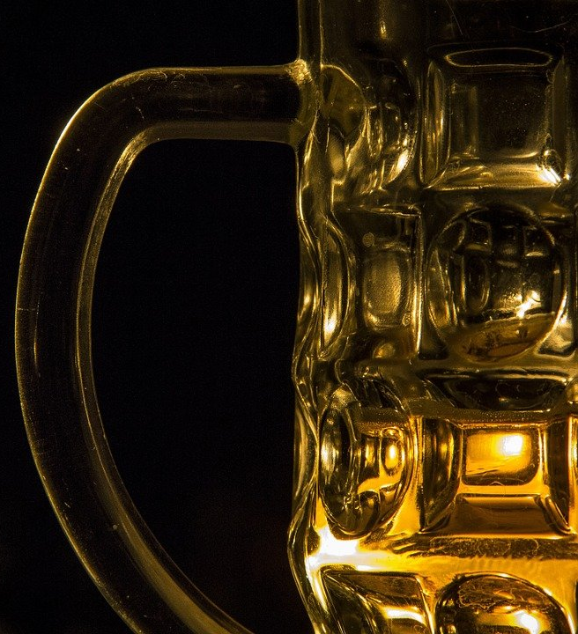
T-Tests
IPAs vs Other Ales
Mean ABV
IPAs > Ales: p<.001 95% [ 1.1, 1.4 ]
Mean IBU
IPAs > Ales: p<.001 95% [ 35.2, 40 ]
Another look at the importance of these two factors

